Slide 1
Health -Recorder
Training :-2 (Python with data science)
Isha Arora
CRN - 2021051
URN -2004930

Slide 2
OVERVIEW
To record and collect information of diseases.
Plotting the graphs .
Analysing the statistics obtained.

Slide 3
Topics to be covered:
Creating a web application using python.
Steps to be followed for creating an application.
Extracting data.
Google Colab
Pandas
Matplotlib
Visualisation
Conclusion

Slide 4
Creating a web application using python:
Flask is a small and lightweight Python web framework that provides useful tools and features that make creating web applications in Python easier. It gives developers flexibility and is a more accessible framework for new developers since you can build a web application quickly using only a single Python file.
The following steps were followed to create an application.

Slide 5
Step-1: Installing Flask Step-2: Creating a Base Application Step-3: Using HTML templates Step -4: Setting up the data base Step -5 : Displaying All Posts

Slide 6
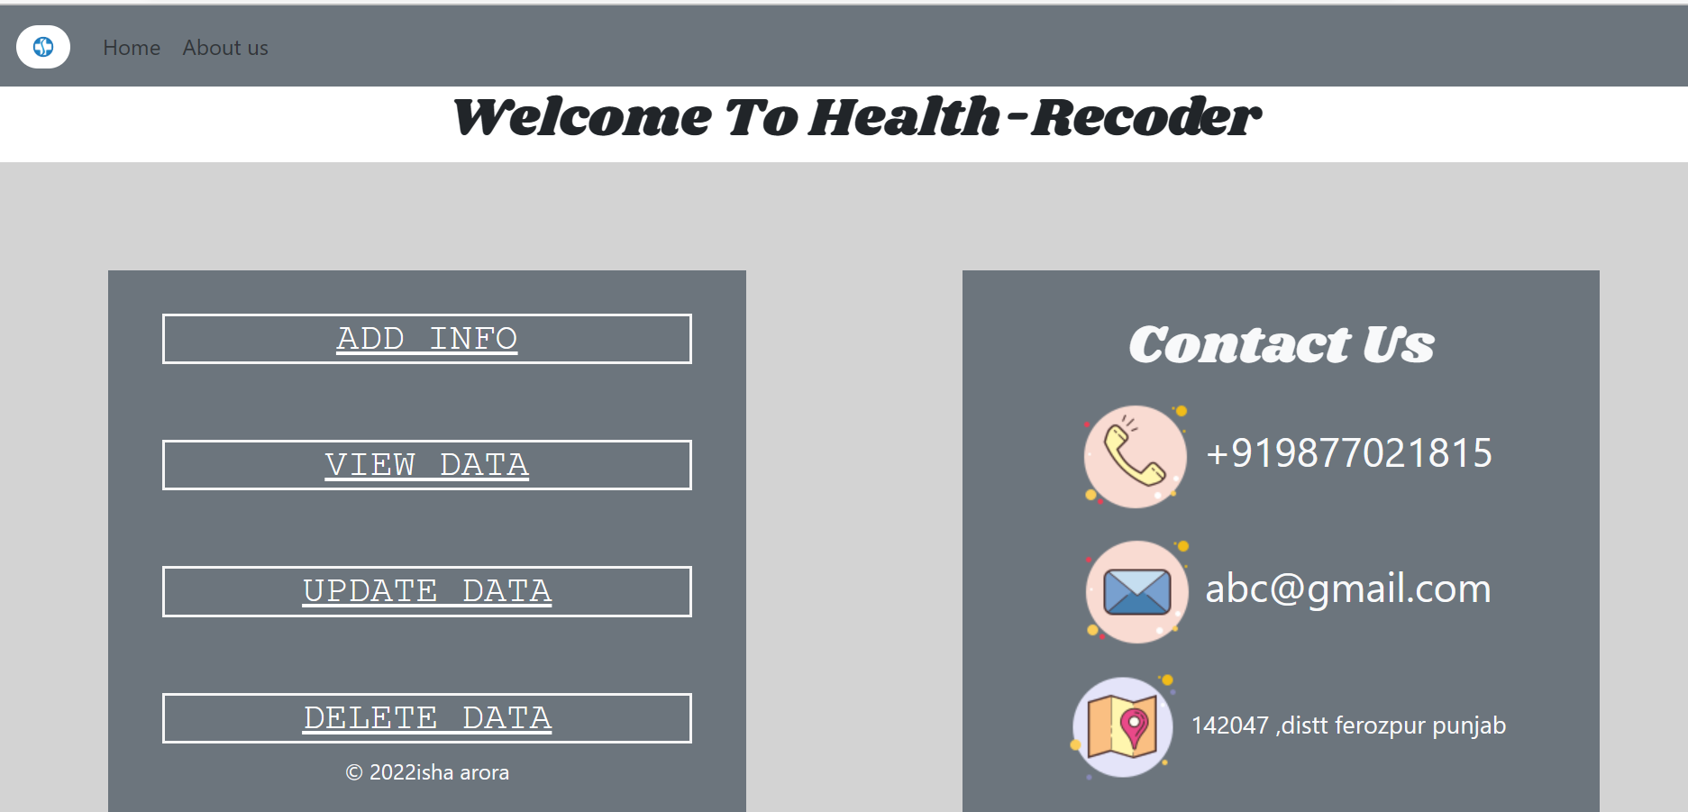

Slide 7
Firebase(Database):
The Firebase Realtime Database is a cloud-hosted database. Data is stored as JSON and synchronized in realtime to every connected client. When you build cross-platform apps with our Apple platforms, Android, and JavaScript SDKs, all of your clients share one Realtime Database instance and automatically receive updates with the newest data.

Slide 8
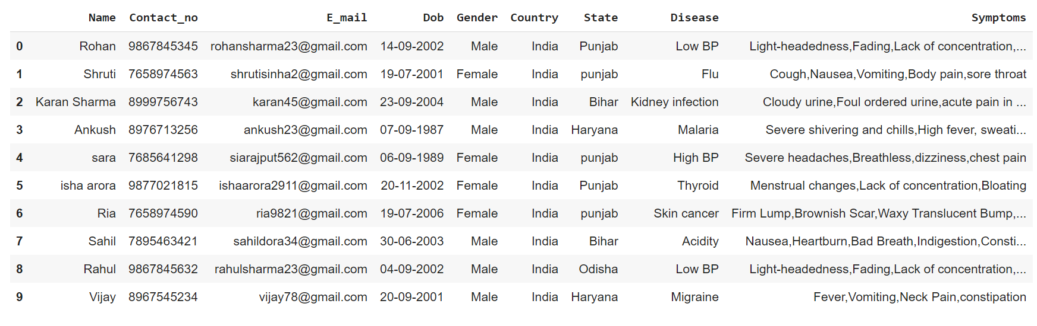
The data that has been recorded in the data base which is in the dictionary format is now collected in the csv file which is in the form of tables.
Extracting Data:

Slide 9
Google Colab: With Google Colab, you can code without having to worry about setting up a local environment. All you need is a browser and an internet connection. Plus, you can access powerful hardware resources that you wouldn’t otherwise have access to. So if you’re looking to get into coding, or want to level up your skills, Google Colab is a great place to start

Slide 10
Pandas:
Pandas is one of the powerful open source libraries in the Python programming language used for data analysis and data manipulation. If you want to work with any tabular data, such as data from a database or any other forms (Like CSV, JSON, Excel, etc.,) then pandas is the best tool.

Slide 11
Matplotlib:
Matplotlib is an amazing visualization library in Python for 2D plots of arrays. Matplotlib is a multi-platform data visualization library built on NumPy arrays and designed to work with the broader SciPy stack. It was introduced by John Hunter in the year 2002.
One of the greatest benefits of visualization is that it allows us visual access to huge amounts of data in easily digestible visuals. Matplotlib consists of several plots like line, bar, scatter, histogram etc.

Slide 12
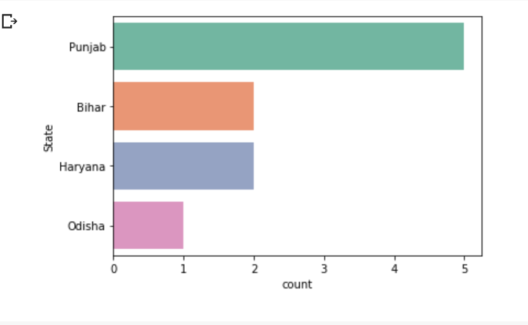
Visualization:

Slide 13
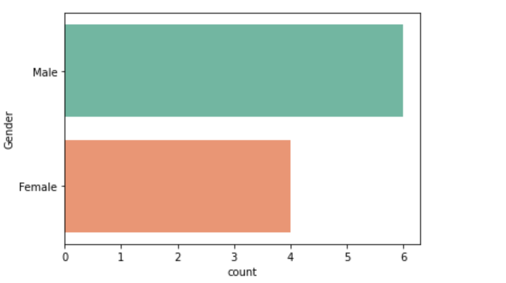

Slide 14
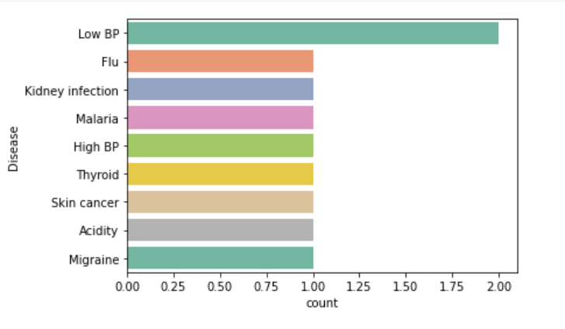

Slide 15
Conclusion:
The aim of the project was to analyse the number of people suffering from the diseases and to compare the ratio of number of male to the number of female and from which disease people are suffering the most and in which state the health rate is low.
And we depict the above mentioned characteristics from the graph.

Slide 16
Thank you

